Slide 1
Rust Modding Tutorial

Slide 2

Rust Modding Tutorial
Installing Rust Server and related tools
  Oxide plugin, Rustedit, Oxide Patcher, DNSpy
Your first map
  Using the basic tools to create a test map
Your first plugin
  Basic structure of a plugin and some tricks, creation of Analyzer plugin for the next steps
What makes a brain?
  Exploration of how NPC brains work, expansion of analyzer to assist in debugging AI states
Liberating the scientist
  Custom hooks using Oxide Patcher, extending states

Slide 3
Assumptions
Familiarity with:
  Command prompt
  C# and OOP programming
  Unity
Windows self-hosted server
  Linux has caveats I will not be covering
  Port forwarding is also out of scope

Slide 4
What will you learn?
How to host and update your server
Basic functionality of Rust Edit
How to create and use custom hooks for your plugins, to extend Oxide
How to analyze server code to create custom mods
How the AI works, and how to manipulate it
Habits that will be hard to break and won’t get your mods approved on umod (sorry wulf)

Slide 5
Installing the server

Slide 6
Installing Rust Server : The Server
https://developer.valvesoftware.com/wiki/SteamCMD
Follow “Downloading SteamCMD steps”
Create a folder to hold your server
D:\steamcmd\steamcmd.exe +force_install_dir D:\rustserver +login anonymous +app_update 258550 validate +quit && exit
Run RustDedicated.exe – Congrats, you have a server!
Run the following in the server window to make yourself admin, then close the server
  ownerid YourSteamIDHere
  server.writecfg

Slide 7
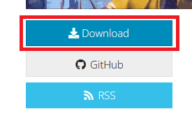
Installing Rust Server : Oxide
https://umod.org/games/rust
Download the latest zip
Export the contents to the root of your
rust server (D:\rustserver), crush the
existing files
Voila!

Slide 8
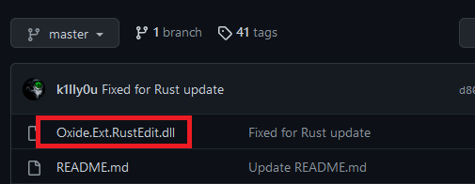
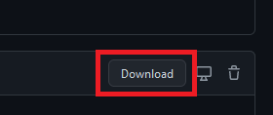
Installing Rust Server : RustEdit.dll
https://github.com/k1lly0u/Oxide.Ext.RustEdit
Place the DLL in your server’s RustDedicated_Data/Managed folder
You can now use custom maps without spawners and deployed items breaking!

Slide 9
Installing the tools

Slide 10
Installing the tools : RustEdit
https://www.rustedit.io/resources/rustedit-launcher.16/
Install then run the launcher.
Once it’s done updating, press play
Select your rust client’s install folder
Default: C:\Program Files (x86)\Steam\steamapps\common\Rust
Exit for now

Slide 11
Adding the breakable monuments
https://lone.design/product/breakable-monuments/
Give these folks some love, they do some really cool stuff and it was incredibly kind of them to release this for free
This lets you break down monuments to their base parts, handy for customizing them
Export the folder to your rustedit’s CustomPrefabs folder.
Default: C:\Program Files (x86)\RustEdit\CustomPrefabs

Slide 12
Installing the tools : Oxide Patcher
Download the patcher (this is a link)
Place the patcher in RustDedicated_Data/Managed
Technically, that’s it for now

Slide 13
Installing the tools : DNSpy
https://github.com/dnSpy/dnSpy/releases
Download the appropriate release for your computer
Export the zip to a good folder (C:\dnspy)
File > Open, then go to the RustDedicated_Data/Managed folder
Select Assembly-Csharp, then open it. Other references will load in as necessary
Close DNSpy so your workspace gets saved

Slide 14
Creating the test map

Slide 15
Creating a plugin

Slide 16
Using block
Not sure which are REQUIRED, but they’re all useful
using Oxide.Plugins;
using Oxide.Core.Plugins;
using Oxide.Core;
using Oxide.Core.Libraries.Covalence;

Slide 17
Basic Plugin
namespace Oxide.Plugins
{
[Info("Analyzer", "PluginAuthor", "0.0.1")]
[Description("Server debugging tool for modders")]
public class Analyzer : CovalencePlugin
{
}
}

Slide 18
What IS a brain?

Slide 19
What IS a brain?
Events
Senses
AIDesign
Brain
Navigator
States
Pathfinder

Slide 20
The analyzer

Slide 21
Creating custom hooks

Slide 22
Creating custom states

